Slide 1


Slide 2

File system - From user’s point of view one of the most important part of the OS.
File system allows the user to create a collection of data called files with the following properties –
1. Long-term existence
  Stored on disk or secondary storage
2. Sharable between processes
  Access can be controlled, with permissions
3. Structure
  Depending on the file structure, a file can have internal structure convenient for a particular application.
  Files can be organized in hierarchy or more complex structure – to reflect relationships among them.

Slide 3
A file system also provides a collection of functions
that can be performed on files.
Create – define new file and position it within file structure.
Delete – remove from the file structure and destroyed.
Open – to allow a process to perform functions on it.
Close – close with respect to a process.
Read – read all or a portion of a file.
Write (update) – add new data, or change values.

Slide 4
File Management System
A set of system software.
The way a user of application may access files is through the FMS
Programmer does not need to develop file management software

Slide 5
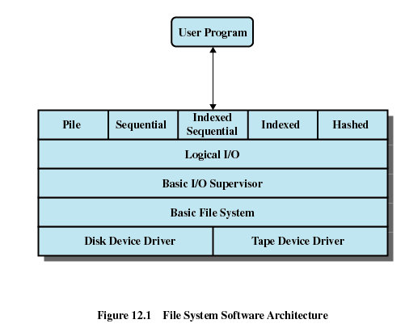

Slide 6

Lowest level
Communicates directly with peripheral devices
Responsible for starting I/O operations on a device
Processes the completion of an I/O request

Slide 7

Physical I/O
Deals with exchanging blocks of data
Concerned with the placement of blocks
Concerned with buffering blocks in main memory

Slide 8

Responsible for file I/O initiation and termination
Control structures are maintained
Concerned with selection of the device on which file I/O is to be performed
Concerned with scheduling access to optimize performance
Part of the operating system

Slide 9

Enables users and applications to access records
Provides general-purpose record I/O capability
Maintains basic data about file

Slide 10

Reflect different file structures
Different ways to access and process data

Slide 11
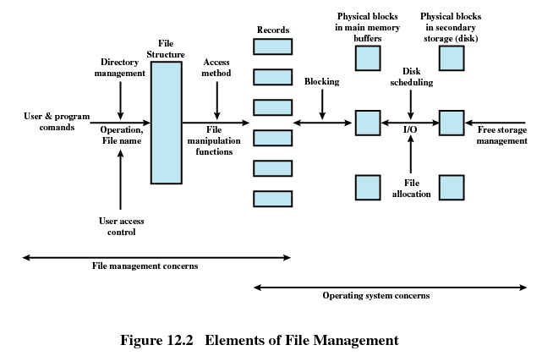

Slide 12

The Pile
  Data are collected in the order they arrive
  Purpose is to accumulate a mass of data and save it
  Records may have different fields
  No structure
  Record access is by exhaustive search

Slide 13

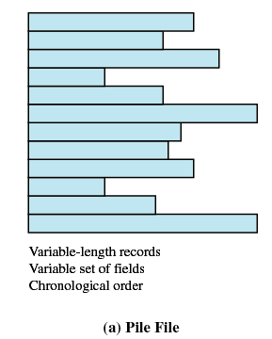

Slide 14
The Sequential File
  Fixed format used for records
  Records are the same length
  All fields the same (order and length)
  Field names and lengths are attributes of the file
  One field is the key filed
    Uniquely identifies the record
    Records are stored in key sequence

Slide 15
The Sequential File
  New records are placed in a log file or transaction file
  Batch update is performed to merge the log file with the master file

Slide 16

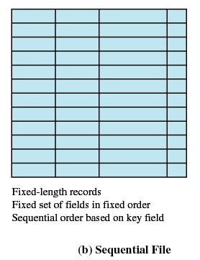

Slide 17

Indexed Sequential File
  Index provides a lookup capability to quickly reach the vicinity of the desired record
    Contains key field and a pointer to the main file
    Indexed is searched to find highest key value that is equal to or precedes the desired key value
    Search continues in the main file at the location indicated by the pointer

Slide 18
Comparison of sequential and indexed sequential
  Example: a file contains 1 million records
  On average 500,00 accesses are required to find a record in a sequential file
  If an index contains 1000 entries, it will take on average 500 accesses to find the key, followed by 500 accesses in the main file. Now on average it is 1000 accesses

Slide 19
Indexed Sequential File
  New records are added to an overflow file
  Record in main file that precedes it is updated to contain a pointer to the new record
  The overflow is merged with the main file during a batch update
  Multiple indexes for the same key field can be set up to increase efficiency

Slide 20

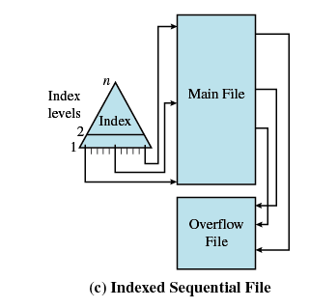

Slide 21

Indexed File
  Uses multiple indexes for different key fields
  May contain an exhaustive index that contains one entry for every record in the main file
  May contain a partial index

Slide 22

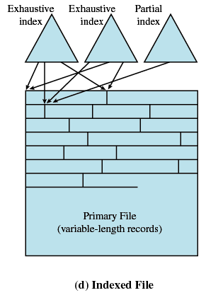

Slide 23

Directly access a block at a known address
Key field required for each record

Slide 24

Contains information about files
  Attributes
  Location
  Ownership
Directory itself is a file owned by the operating system
Provides mapping between file names and the files themselves

Slide 25

List of entries, one for each file
Sequential file with the name of the file serving as the key
Provides no help in organizing the files
Forces user to be careful not to use the same name for two different files

Slide 26

One directory for each user and a master directory
Master directory contains entry for each user
  Provides address and access control information
Each user directory is a simple list of files for that user
Still provides no help in structuring collections of files

Slide 27

Master directory with user directories underneath it
Each user directory may have subdirectories and files as entries

Slide 28
Files can be located by following a path from the root, or master, directory down various branches
  This is the pathname for the file
Can have several files with the same file name as long as they have unique path names

Slide 29
Current directory is the working directory
Files are referenced relative to the working directory

Slide 30
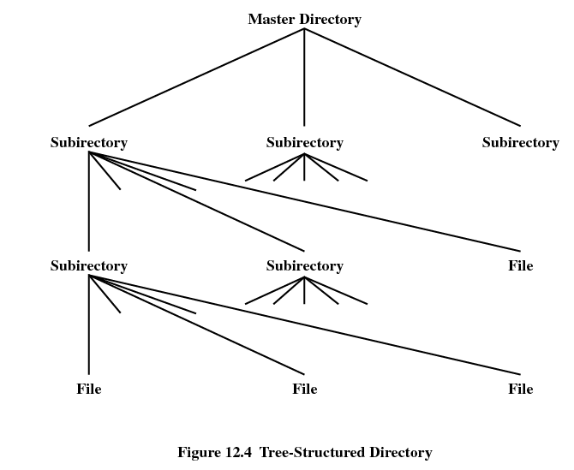

Slide 31

On secondary storage a file is a collection of blocks; the operating system or file management system is responsible for allocating blocks to files
Two management issues
  Space on secondary storage must be allocated to files
  Keep track of the space available for allocation
The approach taken for file allocation may influence the approach taken for available space management

Slide 32
Three common file allocation methods are :
  Contiguous allocation
    Single contiguous set of blocks is allocated to a file at the time of file creation
  Chained allocation
    Each block contains a pointer to the next block in the chain
  Indexed allocation
    The file allocation table contains a separate one level index for each file; the index has one entry for each allocated portion (unit) to the file.

Slide 33
1. Contiguous allocation:
A single contiguous set of blocks assigned to a file when it is created
Only a single entry in the file allocation table showing the starting block and length of the file.
Multiple blocks can be read at a time in case of sequential processing.
Assuming contiguous blocks are stored on one track , disk seek time is minimum.
How to satisfy a request of size n from a list of free holes?
Strategies used are first fit, best fit and next fit.
Disadv
Suffers from external fragmentation.
As files are allocated and deleted, free space on the disk is broken
down into smaller pieces.
Soln : USE COMPACTION

Slide 34

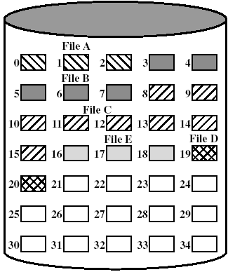
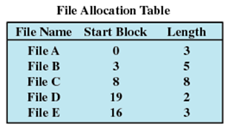
Before Compaction
After Compaction

Slide 35
2. Chained Allocation
Each file is a linked list of disk blocks; the blocks can be scattered anywhere on the disk
Each block contains a pointer to the next block in the chain
File allocation table consists of
  Starting block and length of file
No external fragmentation
  Any free block can be added to a chain
Best for sequential files
No accommodation of the principle of locality

Slide 36
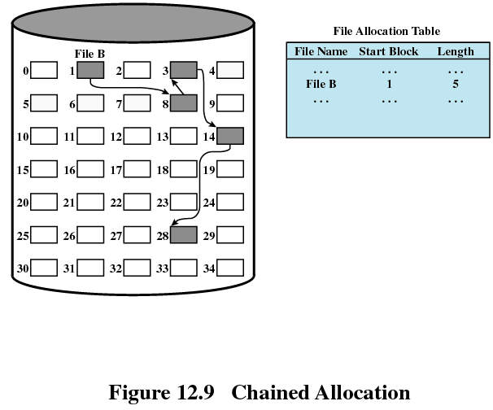
Note : Some FATs may contain start block and end(instead of length)

Slide 37
Disadv :
No accommodation of the principle of locality.
If it is required to bring in several blocks of file at a time, then a series of accesses to different parts of the disk are required (Increase in head movement).

Slide 38
3. Indexed Allocation
File allocation table contains one level index for each file.
The file index for a file is kept in a separate block and the entry for the file allocation table points to that block
  Eliminates external fragmentation

Slide 39
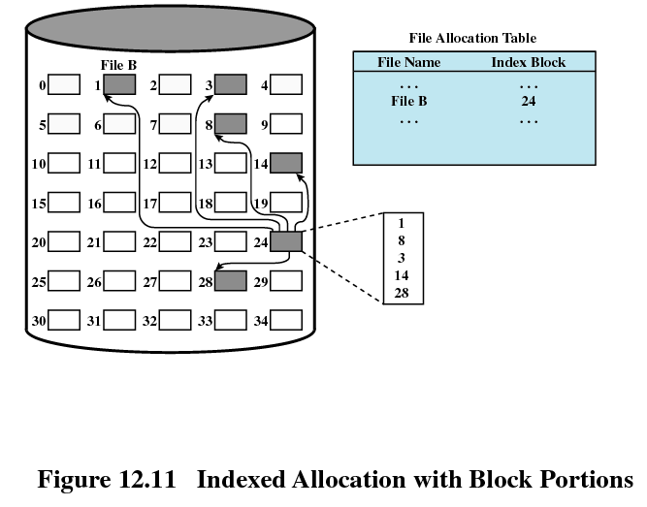

Slide 40

Just as allocated space must be managed, so must the unallocated space.
To perform file allocation, it is necessary to know which blocks are available
A disk allocation table is needed in addition to a file allocation table

Slide 41
1. Bit Tables(Bit vector)
This method uses a vector containing one bit for each block on the disk
Each entry of a 0 corresponds to a free block, and each 1 corresponds to a block in use.
For example, for the disk layout of 35 blocks
00111000011111000011111111111011000
Means 0 1 5 6 7 8 …… are free

Slide 42
Adv:
Easy to find one or more contiguous group of free blocks.
Disadv:
The amount of memory (in bytes) required for a block bitmap is
disk size in bytes/(8 * file system block size)
Thus, for a 16-Gbyte disk with 512-byte blocks, the bit table occupies about
4 Mbytes.
Can we spare 4 Mbytes of main memory for the bit table?

Slide 43
2. Linked list
Link together all the free disk blocks, keeping a pointer to the first free block in a special location on the disk.
This first block contains a pointer to the next free disk block and so on.
Not efficient since to traverse the list we must read each block, which requires a substantial I/O.

Slide 44
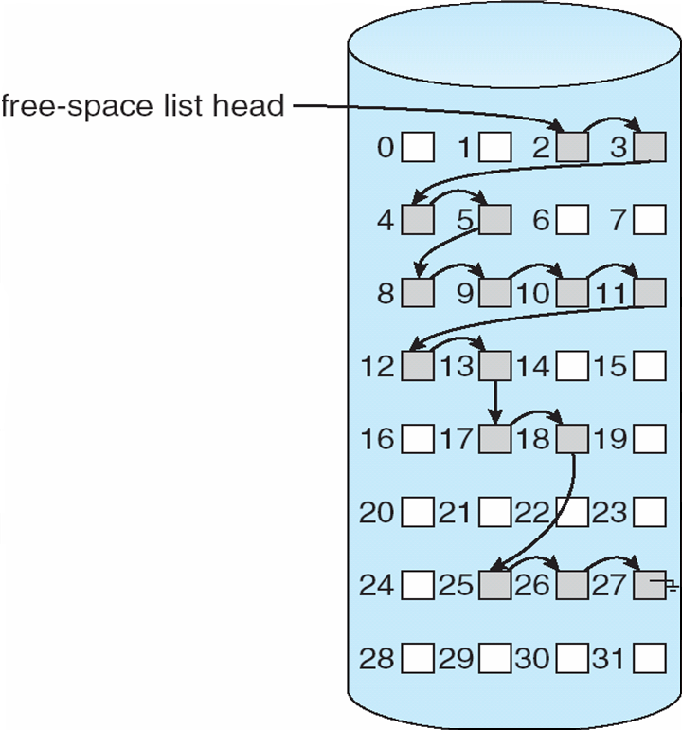

Slide 45
3. Grouping
A modification of the linked-list approach is to store the addresses of n free blocks in the first free block(if the block can hold upto n addresses).
The first n-1 of these are actually free.
The last one is the disk address of another block containing addresses of another n free blocks.
The importance of this implementation is that addresses of a large number of free blocks can be found quickly.

Slide 46
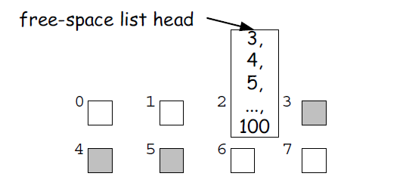

Slide 47
4. Counting
Another approach is to take advantage of the fact that, generally, several contiguous blocks may be allocated or freed simultaneously, particularly when contiguous allocation is used.
Thus, rather than keeping a list of free disk addresses, the address of the first free block is kept and the number n of free contiguous blocks that follow the first block.
Each entry in the free-space list then consists of a disk address and a count.

Slide 48

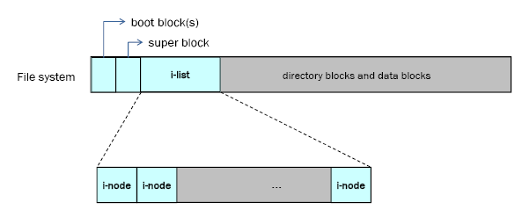
In the original Unix file system, Unix divided physical disks into logical disks called partitions.
Boot block
Super Block
Array of inodes
Directory and data blocks

Slide 49

1. Boot block is located in the first few sectors of a file system. The boot block contains the initial bootstrap program used to load the operating system.
2. Super block consists of
- the size of the file system
- the number of free blocks in the file system
- a list of free blocks available on the file system
- the size of the inode list
- the number of free inodes in the file system
- a list of free inodes in the file system

Slide 50
3. Inode is the data structure that describes the attributes of a file, including the layout of its data on disk.
Every file has a unique inode
Contain the information necessary for a process to access a file
Inode consists of consists of
- file owner identifier
- file type
- file access permissions
- file access times
- number of links to the file
- table of contents for the disk address of data in a file
- file size

Slide 51
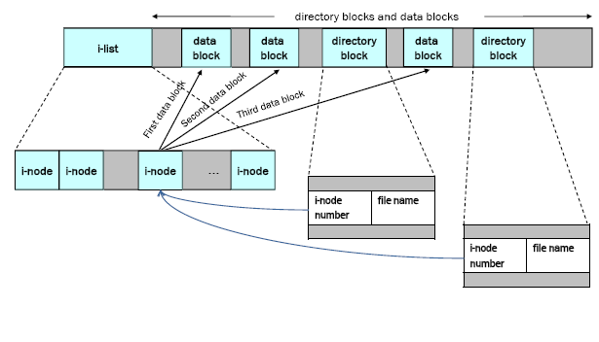
4. Data blocks containing the actual contents of files.
There is a one to one mapping of files to inodes and vice versa.
Thus, while users think of files in terms of file names, Unix thinks of files in terms of inodes.

Slide 52

Each inode contains a table of contents for the disk address of data in a file.
Some unix systems contain 10 directs block numbers, 1 indirect block number, 1 double indirect block number and 1 triples indirect block number.

Slide 53

Inode
Data Blocks
direct0
direct1
direct2
direct3
direct4
direct5
direct6
direct7
direct8
direct9
single indirect
double indirect
triple indirect

Slide 54


Slide 55
Direct block numbers
These contain block numbers that contain the file’s data. Having these gives us direct access to the file’s data.
Indirect block number
This is a block number of a block that contains a list of direct block numbers. Each block number is the number of a block that contains the file’s data.
Double indirect block number
This refers to a block that contains a list of indirect block numbers. Each indirect block number is the number of a block that contains a list of direct block numbers.
Triple indirect block number
This refers to a block that contains a list of double indirect block numbers . Each double indirect block number is the number of a block that contains a list of indirect block numbers. Each of these contains a list of direct block number.

Slide 56
Assume size of each block is 1K(1024) bytes and that a block number is addressable by a 32 bit integer(4-bytes) ,
Then a block can hold up to 256 block numbers (1024bytes / 4bytes)
Inode contains
10 direct blocks, 1 indirect, 1 double-indirect, 1 triple indirect
Capacity =
Direct blocks will address: 1K × 10 blocks = 10,240 bytes
1 Indirect block: additional 256 X 1K = 256K bytes
1 Double indirect block: additional 256 X 256 K =64M bytes
1 Triple indirect block: additional 256 X 64 MB= 16G
Maximum file size = 10,240 + 256K + 64M + 16G =
= 17247250432 bytes ≈ 16G bytes

Slide 57

Block size = 1024 bytes, 10 direct,
indirect/double/triple are 1
How does a process access byte 3073 of a file?
10 direct blocks addresses 10240 bytes of file data.
Since 3073<10240, hence byte 3073 lies in one of
the direct block numbers.
3073/1024=3.0009
Hence 3073 lies in block pointed to by direct entry 3.
Where does the byte lie in that data block(at what offset)?
1024*3=3072
(3073-3072)=1
Hence the byte lies in block pointed to by direct entry 3 and in that data block at offset 1.

Slide 58
Data Block
4096
4096
Data Block
228
Byte no 1
12
Direct
5
5
0
Single
428
Double
9156
Triple
824

Slide 59
Block size = 1024 bytes, 10 direct,
indirect/double/triple are 1
How does a process access byte 11265 of a file?
10 direct blocks addresses 10240 bytes of file data.
Since 11265>10240, hence byte 11265 lies within
single indirect block number.
11265-10240=1025(within single indirect it is byte no
1025)
Which entry within single indirect block no?
1025/1024=1.0009
Entry numbered 1(Assuming it starts from 0)
In this entry there is a data block no.
Which offset within this block?
1025-(1x1024)=1 {byte offset 1}

Slide 60
Block size = 1024 bytes, 10 direct, indirect/double/triple are 1
Case 1 : Access byte offset 9000 of a file.
Case 2 : Access byte offset 350,000 of a file.

Slide 61


0
4096
Data Block
228
808 th
(9000-1024*8)
Direct
Case 1
367
8
367
Double Indirect (start from 10K + 256K = 272,384)
9
0
Data Block
Case 2
Single
428
331
816 th
Double
350,000
- 272,384
= 77,616
75
3333
9156
Triple
824
331
3333
9156
75x1024=76800
77616-76800=816

Slide 62
0
75
45
Eg
3333
Data blk
5
331
55
Data blk
234
140
816
Data blk
2
331
3333
140
12
266
266
167
9
9156
121
Double Indirect blk no
126
16
Data blk
9

Slide 63
If a process wants to access byte offset 350,000 in the
file, it must access a double indirect block, number 9156
in the figure.
Since an indirect block has room for 256 block
numbers, the first byte accessed via the double indirect
block is byte number 272,384 (256K + 10K)
Byte number 350,000 in a file is therefore byte number
77,616 of the double indirect block.
Since each single indirect block accesses 256K bytes,
byte number 350,000 must be in the 0th single indirect
block of the double indirect block — block number 331.

Slide 64
Since each direct block in a single indirect block contains IK bytes, byte number 77,616 of a single indirect block is in the 75th direct block in the single indirect block — block number 3333.
Finally, byte number 350,000 in the file is at byte number 816 in block 3333.

